Slide 1
~ or ~
Salvation from Start to Finish
SOTERIOLOGY
from Genesis to Revelation

Slide 2
Twelve-Week Schedule
Introduction (12/1/19)
The Problem Defined (Anthropology and Hamartiology) (12/8/19)
Salvation Promised (12/15/19)
The Lamb of God #1 (12/22/19)
The Lamb of God #2 (12/29/20)
The Role of the Holy Spirit (1/5/20)
Provisions of Salvation (Election) (1/12/20)
Provisions of Salvation (Atonement) (1/19/20)
Provisions of Salvation (Sanctification) (1/26/20)
No Sunday School (2/2/20)
Security (2/9/20)
The Gospel Ministry of Salvation (2/16/20)
The Daily Walk of Salvation (2/23/20) www.davenancymorris.com

Slide 3
Testimony
Nancy Morris

Slide 4
Review
Sanctification
  WCF 13.1-3
  We are sanctified at regeneration.
  We are set apart (positional).
  We yearn to be more “set apart” (practical).
  We will be sanctified completely (perfect).

Slide 5
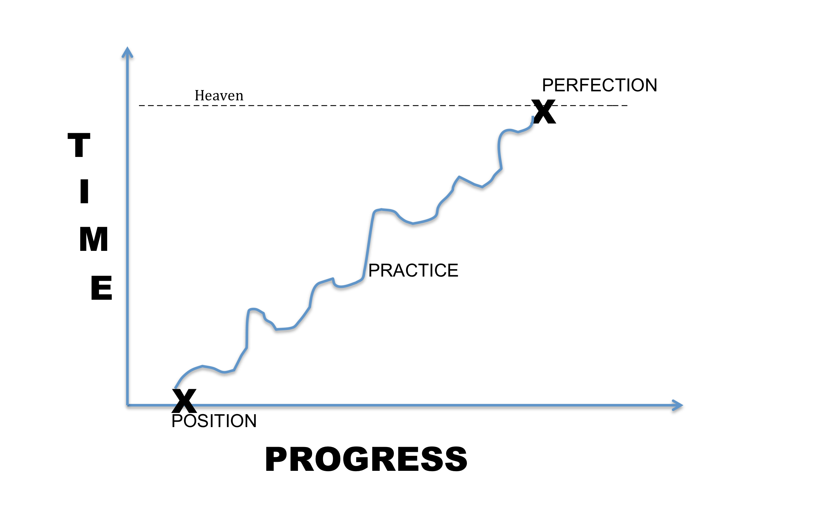
Review

Slide 6
Security
What is a connection between salvation and security?
Is security the same
  as perseverance?
    close
  as preservation?
    close
  as assurance?
    Probably not
    More of the realization of the truth of security
    Confidence; freedom from doubt
    Subjective in many ways
Does security make any difference in our lives?

Slide 7
Security
Definitions of security
  Freedom from risk or danger; safety
  Freedom from doubt, anxiety, or fear; confidence
  Something deposited or given as assurance of the fulfillment of an obligation
From a soteriological standpoint, when we consider #3, #1 and #2 seem to follow.

Slide 8
Security
Our assurance of salvation can be shaken by:
  Doubt as to the validity (was it real) or timing (when did it happen) of our salvation
  Correctness of the process
  Poor or incorrect theology (Arminianism)
  Sin, especially, the more serious sins

Slide 9
Security
Sometimes, I wish that the five “solas” were arranged differently.
  Sola fide
  Sola gratia
  Solus Christus
  Soli Deo gloria
  Sola scriptura
We are driven to the readable, to the source.

Slide 10
Sola Scriptural Security
In the following scriptures, what do we learn of our security?
Psalm 139:1-3, 7, 16
  God’s knowledge of us is not just facts but brings about relationship.
  Do you see comfort?
  Do you see confidence?
Romans 8:31
  Protection?
  Assurance based on knowledge about God and knowledge of God

Slide 11
Sola Scriptural Security
II Corinthians 5:17, 18
  It’s all of Him.
  We do not create ourselves.
Jude 24,25
  Comfort
  Preservation
  One of the reasons for creation?
John 10:27-30
  Are you able to snatch yourself out of the Father’s hands?
  Sheep are needy.
  Our Lord loves to meet those needs.

Slide 12
Sola Scriptural Security
John 17:6, 10, 20
  The transaction between Father and Son did not, does not, have any hidden exclusions.
Psalm 139:17, 18
  Security is one of God’s “thoughts” that we will never, ever, ever completely grasp.
  Two types of awakenings
    Tomorrow morning in your bed
    In heaven

