Slide 1
~ or ~
Salvation from Start to Finish
SOTERIOLOGY
from Genesis to Revelation

Slide 2
Twelve-Week Schedule
Introduction (12/1/19)
The Problem Defined (Anthropology and Hamartiology) (12/8/19)
Salvation Promised (12/15/19)
The Lamb of God #1 (12/22/19)
The Lamb of God #2 (12/29/20)
The Role of the Holy Spirit (1/5/20)
Provisions of Salvation (Election) (1/12/20)
Provisions of Salvation (Atonement) (1/19/20)
Provisions of Salvation (Sanctification) (1/26/20)
No Sunday School (2/2/20)
Security (2/9/20)
The Gospel Ministry of Salvation (2/16/20)
The Daily Walk of Salvation (2/23/20) www.davenancymorris.com

Slide 3
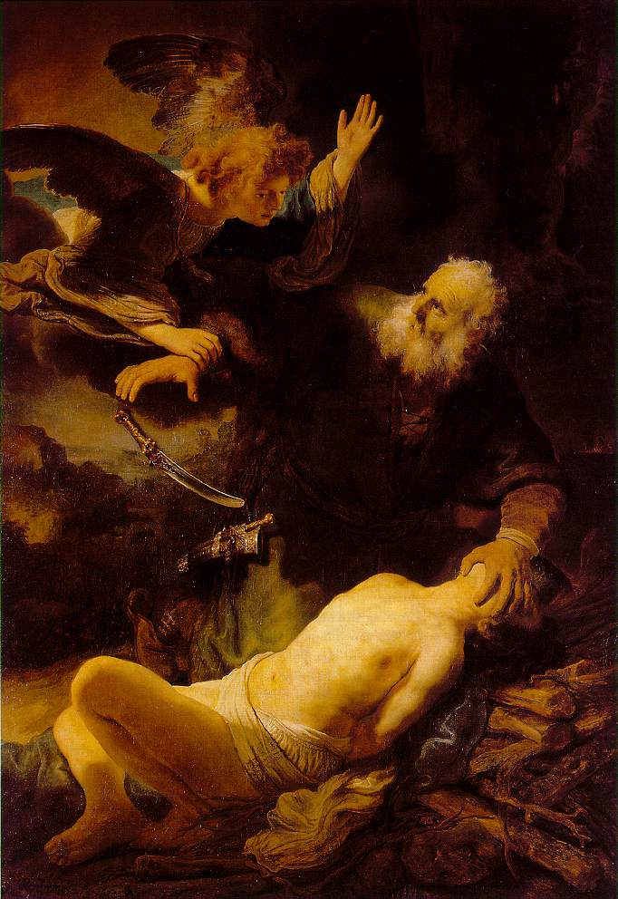
Review
Atonement is ultimately about what Christ has done on the cross, prefigured in the rituals of the OT sacrifices
Concept of Atonement is found throughout the OT
  God continued to teach His people that their sins must be atoned for, literally covered
  Atonement associated to the concept of the Messiah who would fully atone for the sins of God’s people
  “The blood of bulls and goats could never take away sins”

Slide 4
Review
Atonement in the OT
  Animal sacrifice
    Sins confessed and symbolically transferred to the animal
  Day of Atonement
    Sacrifices made for all the people
Atonement in the NT
  OT sacrifices now realized in Christ who makes perfect atonement for His people
  Christ is the perfect sacrificial Lamb who takes away the sins of His people once and for all
  Atonement is particular rather than universal – Christ atones for the sins of His sheep alone

Slide 5
Testimony
Andrew McCallum

Slide 6
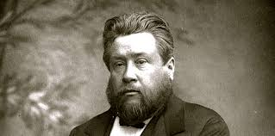
Theology and Mystery
The historic Christian church has debated many theological issues, sometimes attempting to define a given theological truth, and sometime proclaiming it to be a “mystery”
There are elements of mystery in the following doctrines:
  The Trinity
  Christ as divine and human
  God’s sovereignty and man’s free will
But there are elements of God’s working that he has made known to us and we must seek to defend them through our confessions and creeds
Question to Charles Spurgeon:
How do you reconcile the sovereignty of God in salvation with man’s free will?
Spurgeon’s answer:
I never try to reconcile friends

Slide 7
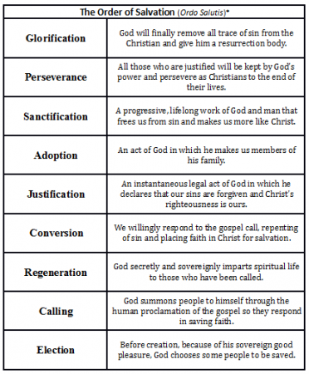
The Ordo Salutis
There is a logical progression of God’s working in His people’s lives that began before time began, and only ends in their glorification in the New Heavens and Earth
We call this process the “Ordo Salutis,” the order of salvation

Slide 8
Justification and Sanctification
How do we distinguish Justification and Sanctification?
  What is the work of Christ?
  What is our work?
The Reformed understanding of Justification and Sanctification are distinguished properly when we understand the role that Christ plays in our salvation
Why is the Reformed understanding these of doctrines so difficult for many people to understand?

Slide 9
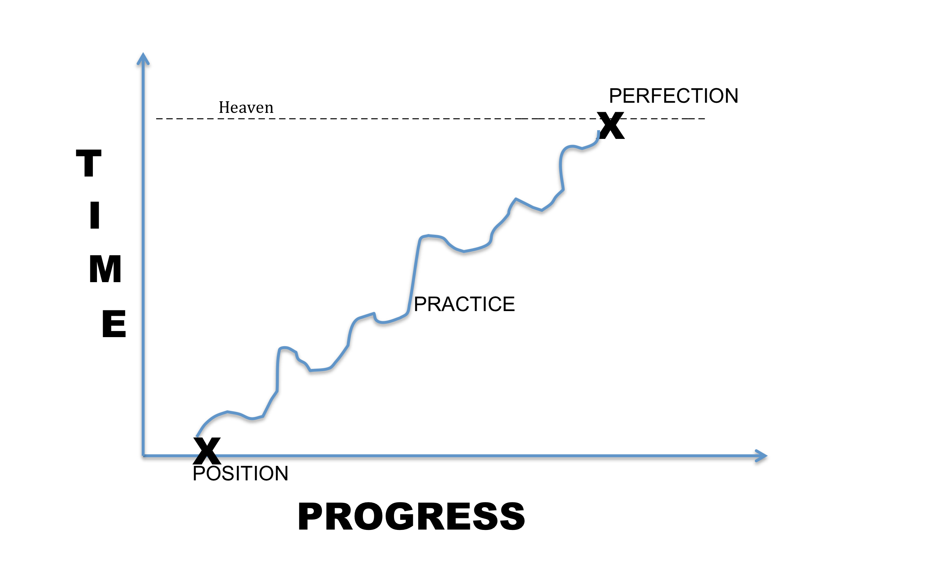
Sanctification – WCF 13:1
They, who are once effectually called, and regenerated, having a new heart, and a new spirit created in them, are further sanctified, really and personally, through the virtue of Christ's death and resurrection, by his Word and Spirit dwelling in them: the dominion of the whole body of sin is destroyed, and the several lusts thereof are more and more weakened and mortified; and they more and more quickened and strengthened in all saving graces, to the practice of true holiness, without which no man shall see the Lord.

Slide 10
Sanctification – WCF 13:1
This section tells us about the dimensions of sanctification
God effectually calls and revitalizes those who are spiritually dead. He gives them new heart, a new spirit, and a new life
Those God regenerates he also sanctifies - personally set apart and made holy
Sanctification is God's work, sanctification only happens in Christ

Slide 11
Meaning of Sanctification
The basic meaning of “sanctify” is to set apart to God, for His use. But God works in those whom He claims as His own to conform them “to the image of his Son”
  Rom. 8:29
This moral renovation, in which we are increasingly changed from what we once were, flows from the agency of the indwelling Holy Spirit
  Rom. 8:13
  1 Cor. 6:11, 19, 20
  2 Cor. 3:18
  Eph. 4:22–24
  1 Thess. 5:23; 2 Thess. 2:13; Heb. 13:20, 21)
God calls His children to holiness, and graciously gives what He commands
  1 Thess. 4:4; 5:23

Slide 12
Sanctification – WCF 13:2,3
This sanctification is throughout, in the whole man; yet imperfect in this life, there abiding still some remnants of corruption in every part whence ariseth a continual and irreconcilable war, the flesh lusting against the Spirit, and the Spirit against the flesh
In which war, although the remaining corruption, for a time, may much prevail; yet, through the continual supply of strength from the sanctifying Spirit of Christ, the regenerate part doth overcome; and so, the saints grow in grace, perfecting holiness in the fear of God

Slide 13
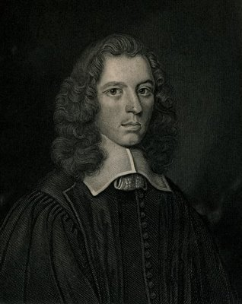
The Father and Sanctification
In God the Father we behold the nature of holiness and hear the call to holiness (I Peter 1:14-16)
The character of the Father sets the moral and ethical standard to which our character must be conformed (Matt. 5:48)
The Father is the great architect of our salvation, and therefore, of our sanctification (Eph. 1:3-4)
As his power is the strength of [his perfections], so his holiness is the beauty of them. As all would be weak, without almightiness to back them, so all would be uncomely without holiness to adorn them . . . [holiness] is the rule of all his acts, the source of all his punishments. If every attribute of the Deity were a distinct member, purity would be the form, the soul, the spirit to animate them. Without it, his patience would be an indulgence to sin, his mercy a fondness, his wrath a madness, his power a tyranny, his wisdom an unworthy subtlety. It is this gives a decorum to all.
--Stephen Charnock, Existence and Attributes of Go

Slide 14

The Son and Sanctification
In Christ we see fully realized human holiness, the perfect model of incarnate holiness, the one truly sanctified human being (Heb. 7:26)
We are, therefore, to imitate Christ, to seek to conform the contours of our character to his holy image (II Cor. 3:18)
The Son is the source of our sanctification. In fact, he is our sanctification. We are sanctified in him, the supremely sanctified One (John 17:17-19, I Cor. 1:30-31)
One of Christ’s great purposes in dying for us on the cross was to make us holy (Heb. 10:10,14)
Christ is our sanctification. In him it has first come to its fulfillment and consummation. He not only died for us to remove the penalty of our sin by taking it himself; he has lived, died, risen again, and been exalted in order to sanctify our human nature in himself for our sake… Jesus lived his life of perfect holiness in our frail flesh set in a world of sin, temptation, evil and Satan…. When he cried out on the cross ‘It is finished’ (Jn 19:30; see also 17:4) and with royal dignity committed his spirit into the hands of his Father, he was the first person to have lived a life of perfect obedience and sanctification…
--Sinclair Ferguson, “The Reformed View” in Christian Spirituality: Five Views of Sanctification

Slide 15
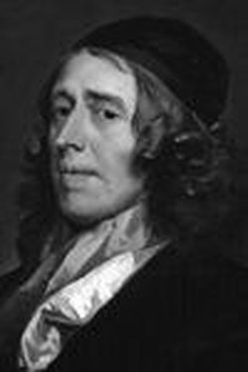
The Spirit and Sanctification
The Spirit is the agent of our sanctification in Christ, the “bond of our union” with Christ We are, therefore, to imitate Christ, to seek to conform the contours of our character to his holy image (II Thess. 2:13-14)
The Spirit is the author of regeneration, the one who indwells us as the Spirit of Christ, giving us new life in him (Titus 3:5-6, Rom. 8:9-10)
The Spirit is the One by whose strength we are empowered and through whose energy we produce the fruit of Christlike character (Eph 3:16)
The Spirit leads us into Christlikeness by fixing our gaze steadfastly on Christ himself (II Cor. 3:18)
These words show us how we can have communion with God. We cannot go directly on our own to the Father, nor does the Father deal directly with us. We can only approach the Father by Christ, for it is only by him we have access into the Father’s presence….But without the Holy Spirit’s work, we cannot even come to the Father by Christ. As the things of the Father are deposited in Christ and brought to us by the Spirit, so the Holy Spirit teaches us how to pray and what to pray for. These prayers are, as it were, deposited with Christ, and Christ brings them to the Father.
--John Owen, The Holy Spirit

Slide 16
The Work of the Trinity
Father
Son
Spirit
You
Spirit
Son
Grace, strength, and glory come to us from the Father through the Son applied by the Spirit
Faith, prayer, and worship go from us by the Spirit through the Son to the Father
God has granted us all of the means as a gracious gift of the Father working through the Son and the Spirit by which we become more conformed to the Image of Christ

Slide 17
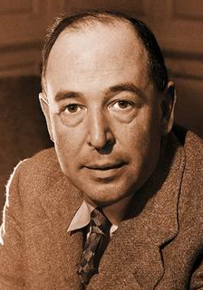
Sanctification is about our relationship to God
In Christianity God is not a static thing—not even a person—but a dynamic, pulsating activity, a life, almost a kind of drama. Almost, if you will not think me irreverent, a kind of dance. . . .The whole dance, or drama, or pattern of this three-Personal life is to be played out in each one of us: or (putting it the other way round) each one of us has got to enter that pattern, take his place in that dance. There is no other way to the happiness for which we were made. Good things as well as bad, you know, are caught by a kind of infection.
If you want to get warm you must stand near the fire: if you want to be wet you must get into the water. If you want joy, power, peace, eternal life, you must get close to, or even into, the thing that has them. They are not a sort of prize which God could, if He chose, just hand out to anyone. They are a great fountain of energy and beauty spurting up at the very centre of reality. If you are close to it, the spray will wet you: if you are not, you will remain dry.
--C. S. Lewis, Mere Christianity

Slide 18
Two Weeks from Now
Security

