Slide 1
A Christian Worldview
How Do You See The World

Slide 2
Outline
Where did I come from
Worldview I
Worldview II
Did it start at creation ?
Why did the created disagree with the creator ?
What am I Doing Here
Redemption
A disciplined life is an unburdened life
Music, art, literature
Apologetics 1
Apologetics 2
It’s a matter of birth and death
Reflecting the Diving
Where Am I Going
Heaven, Hell or Oblivion
A light at the end of the Tunnel

Slide 3
Review
“To have a Christian-Biblical ‘Worldview’ is to have the perspective of seeing the world as God sees it.” - Rev. Steve Jennings
What are the implications ?
Perspective of Time (a lifetime, an empire, or eternity…)
Perspective of purpose & meaning (for man or for God)
Perspective of substance (of matter or of spirit)
Notes:
John 8:58–59 Jesus said to them, “Truly, truly, I say to you, before Abraham was, I am.” So they picked up stones to throw at him, but Jesus hid himself and went out of the temple.
Matthew 5:18–20 For truly, I say to you, until heaven and earth pass away, not an iota, not a dot, will pass from the Law until all is accomplished. Therefore whoever relaxes one of the least of these commandments and teaches others to do the same will be called least in the kingdom of heaven, but whoever does them and teaches them will be called great in the kingdom of heaven. For I tell you, unless your righteousness exceeds that of the scribes and Pharisees, you will never enter the kingdom of heaven.

Slide 4





Slide 5
Review
1 Peter 3:14–16
But even if you should suffer for righteousness’ sake, you will be blessed. Have no fear of them, nor be troubled, but in your hearts honor Christ the Lord as holy, always being prepared to make a defense to anyone who asks you for a reason for the hope that is in you; yet do it with gentleness and respect, having a good conscience, so that, when you are slandered, those who revile your good behavior in Christ may be put to shame.
But even if you should suffer for righteousness’ sake, you will be blessed. Have no fear of them, nor be troubled, but in your hearts honor Christ the Lord as holy, always being prepared to make a defense to anyone who asks you for a reason for the hope that is in you; yet do it with gentleness and respect, having a good conscience, so that, when you are slandered, those who revile your good behavior in Christ may be put to shame.

Slide 6
Worldview II
we need to be fully prepared to understand when and where those worldviews come into collision with Christianity and how to avoid collisions that may be disastrous.
- Sproul

Slide 7

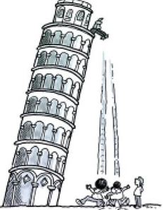
Worldview II - Falsehoods
What weighs more – a ton of bricks or a ton of feathers ?
What falls faster – a rock or feather ?

Slide 8
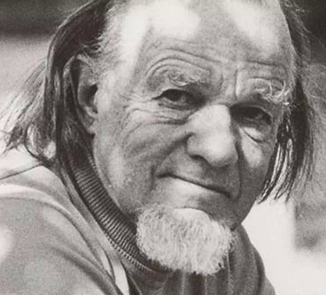
Worldview II - Falsehoods
As Christians what are potential falsehoods we have about Worldviews ?
Christianity is a competing worldview
  False because the premise of God is that which is greater than creation therefore the concept by definition cannot be judged by the created
  Schaeffer – presuppositionalism
  We must protect our faith and let others make up their own minds
  Ezekiel 33 – being watchman and guilt for not sounding the warning
  Great commission
  We must convince the world of the falsehood
  Ephesians 5:7-16 – discern what is pleasing to the Lord (we do it for God, not for others)
  Matthew 4:9 – 3rd temptation
  Matthew 13:13 – seeing do not see, hearing they do not hear
Notes:
Premise that Christianity is a ‘competing’ worldview is false
Schaeffer presuppositional apologetics
Fallacy that God can be evaluated by human knowledge – for all knowledge is based on a priori knowledge
What is the solution: Worldview is really struggle of pride vs humility – we can fall into same trap
I can take care of the world by myself as I see fit
Christian opposition against secular worldview can be same from pride “my faith can change the world”
Christian command is to obey
Read
Ezekiel 33: 7 – 9 - Watchman
Ephesians 5:7-16 - and try to discern what is pleasing to the Lord.
Matthew 4:9 – Not to win kingdoms but to obey God
Matthew 13:13 - to go to the elect who only God knows

Slide 9
Worldview II - Falshoods
Common Worldviews (from Anderson)
Naturalism: there is no God; humans are just highly evolved animals; the universe is a closed physical system.
Postmodernism: there are no objective truths and moral standards; “reality” is ultimately a human social construction.
Pantheism: God is the totality of reality; thus, we are all divine by nature.
Pluralism: the different world religions represent equally valid perspectives on the ultimate reality; there are many valid paths to salvation.
Islam: there is only one God, and He has no son; God has revealed His will for all people through His final prophet, Muhammad, and His eternal word, the Qur’an.
Moralistic therapeutic deism: God just wants us to be happy and nice to other people; He intervenes in our affairs only when we call on Him to help us out.
Notes:
What is the problem: Worldview is about view of self and view of God
Genesis – “did God say… “
Tower of Babel
– that man can do all things like God
– pride of man against God.
Christians must be careful about pious pride (Pharisees) when looking at worldviews lest we find ourselves in a position of pride rather than submission / obedience to God for God.
The Cross is model to showing truth – obedience to God for the glory of God
Must not forget our purpose is to show people Christ – not comparative religion by eloquence I Cor 1:18 – 25
For the word of the cross is folly to those who are perishing, but to us who are being saved it is the power of God. For it is written,
“I will destroy the wisdom of the wise,
and the discernment of the discerning I will thwart.”
Where is the one who is wise? Where is the scribe? Where is the debater of this age? Has not God made foolish the wisdom of the world? For since, in the wisdom of God, the world did not know God through wisdom, it pleased God through the folly of what we preach to save those who believe. For Jews demand signs and Greeks seek wisdom, but we preach Christ crucified, a stumbling block to Jews and folly to Gentiles, but to those who are called, both Jews and Greeks, Christ the power of God and the wisdom of God. For the foolishness of God is wiser than men, and the weakness of God is stronger than men.

Slide 10
Review
1 Peter 3:14–16
But even if you should suffer for righteousness’ sake, you will be blessed. Have no fear of them, nor be troubled, but in your hearts honor Christ the Lord as holy, always being prepared to make a defense to anyone who asks you for a reason for the hope that is in you; yet do it with gentleness and respect, having a good conscience, so that, when you are slandered, those who revile your good behavior in Christ may be put to shame.
But even if you should suffer for righteousness’ sake, you will be blessed. Have no fear of them, nor be troubled, but in your hearts honor Christ the Lord as holy, always being prepared to make a defense to anyone who asks you for a reason for the hope that is in you; yet do it with gentleness and respect, having a good conscience, so that, when you are slandered, those who revile your good behavior in Christ may be put to shame.

Slide 11
Outline
Where did I come from
Worldview I
Worldview II
Did it start at creation ?
Why did the created disagree with the creator ?
What am I Doing Here
Redemption
A disciplined life is an unburdened life
Music, art, literature
Apologetics 1
Apologetics 2
It’s a matter of birth and death
Reflecting the Diving
Where Am I Going
Heaven, Hell or Oblivion
A light at the end of the Tunnel

