Slide 1
A Christian Worldview
How Do You See The World

Slide 2
Outline
Where did I come from
Worldview I
Worldview II
Did it start at creation ?
Why did the created disagree with the creator ?
What am I Doing Here
Redemption
A disciplined life is an unburdened life
Music, art, literature
Apologetics 1
Apologetics 2
It’s a matter of birth and death
Reflecting the Divine
Where Am I Going
Heaven, Hell or Oblivion
A light at the end of the Tunnel
(PP’s at davenancymorris.com > Worldview > A Christian Worldview)

Slide 3




“To have a Christian-Biblical worldview is to have the perspective
Of seeing the world as God sees it. Rev. Steve Jennings

Slide 4
Review
Last week was “Music, Art, and Literature”
Biblical beauty of these disciplines does some things:
  It attracts
  It awakens
  It stimulates love
“Beauty would be characterized in terms of: Harmony, color, symmetry, balance, ordered design, fluidity, gracefulness, functionality, weightiness, form being coordinate with purpose, luminance, radiance, the power to move the soul. For music we would include: volume, pitch, tempo, timbre, major or minor key, resolution, coordination of mood, melody, and lyrics.” Jennings
  I would add that beauty communicates
Steve stated “…now of Music. It inherently has the power to move the affections. The emotions are a necessary component of sanctification.”
  We will try to illustrate this later.
Questions/comments?

Slide 5
What Am I Doing Here?
Apologetics I or There Are No Dumb Questions
Some definitions and terms
  Apologetics: ”As a subdivision of Christian theology, is a systematic argumentative discourse in defense of the divine origin and the authority of the Christian faith.” Evangelical Dictionary of Theology
  Apologetics: “A reasoned defense of the Christian religion”
  Classical Apologetics, Sproul, Gerstner, and Lindsey
  From the Greek verb, apologeomai, and the noun, apologia:
    “to defend, to make reply, to give an answer, to legally defend oneself”
  How about a new term: apollosetics?
    Acts 18:24-28

Slide 6
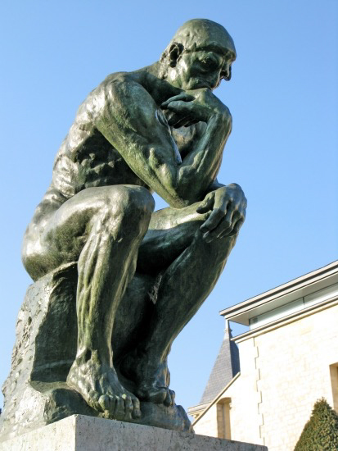
Would you agree that
defending the faith (apologetics)
requires thinking?
Le Penseur
by
Auguste Rodin
Notes:
And here he is in person

Slide 7
Apologetics I or There Are No Dumb Questions
Why is apologetics part of this study on worldview?
  You never know.
    You may be in Katy, Texas (or Athens, Greece), and someone may come up to you and say:
      “What does this babbler wish to say?”
      “May we know what this new teaching is that you are presenting?
      (exerted from Acts 17:18,19)
    You may be given an assignment from the Holy Spirit today.
      “Now an angel of the Lord said to Philip, “Rise and go toward the south^{[a]} to the road that goes down from Jerusalem to Gaza.” This is a desert place. ²⁷ And he rose and went. And there was an Ethiopian, a eunuch…”
      (Acts 8:26, 27)

Slide 8
Apologetics I or There Are No Dumb Questions
Why is apologetics part of this study on worldview? (cont.)
  You should know
    and prepare.
    Romans 10:1
      “Brothers, my heart's desire and prayer to God for them is that they may be saved.”
      This should be our attitude as well Paul’s.
    I Peter 3:13-17
      We usually emphasize v. 15 and appropriately so, but…
      in this context, we may have to “make a defense” in an adversarial setting.
        Note the implied, imposed engagement.
        Defense = apologia (“to defend, to make reply, to give an answer, to legally defend oneself”)
      Our situation does not control us; we control it.
      What are we defending?
        “the hope that is in you”
        Hope cannot be argued, but it can be offered.
      We’re Prepared; we Engage; we Empathize; we Respect (PEER)

Slide 9
Apologetics I or There Are No Dumb Questions
Why is apologetics part of this study on worldview? (cont.)
  Exodus 4:10-12
    Do you see something of yourself in Moses?
    All the head knowledge of theology has limited value if not combined with faith and obedience.
    What defect would you hide behind?
    If we see the world as God sees it, we will want to speak of Him and for Him.
    Do you see a promise here?
      “ Now therefore go, and I will be with your mouth and teach you what you shall speak.”
      This should be an overarching principle of apologetics.

Slide 10

Apologetics I or There Are No Dumb Questions
Why is apologetics part of this study on worldview? (cont.)
  Isaiah 1:18
    What a personal relationship!
    An invitation-command.
    What are we to reason with God about?
      Or, what are we not to reason with God about?
    A prerequisite for making a defense?
    Ken Medema
Steve stated “…now of Music.
It inherently has the power to move the affections.
The emotions are a necessary component of sanctification.”
Notes:
Start at 1:42

Slide 11
Apologetics I or There Are No Dumb Questions
Why is apologetics part of this study on worldview? (cont.)
  II Corinthians 10:4, 5
    No passivity here
    To do v. 5, we should know some “arguments” and “lofty opinions.”
    Whose thought are we to take captive?
      Probably ours first and then, theirs.
  Philippians 1:15-18
    V. 16 shows Paul understood apologetics.
    It was part of who he was and
      it should be part of us.

Slide 12
Apologetics I or There Are No Dumb Questions
Why is apologetics part of this study on worldview? (cont.)
  Jude 3
    Do we have the same responsibility?
    There is a season for learning and teaching, and there is a season to “contend for the faith.”
    What does “faith that was once for all delivered to the saints” mean?
      Our faith is no different that Jude’s or Paul’s.
      We stand on broad and strong shoulders.
  Titus 1:9
    Knowing sound doctrine comes before being able to rebuke.
    This is required of an elder; it may be required of any believer.

Slide 13
Apologetics I or There Are No Dumb Questions
Why is apologetics part of this study on worldview? (cont.)
  II Corinthians 5:20
    Does it occur to you that God is taking a risk here?
    The Spirit, through Paul, must be speaking of someone else besides us!
    Our “apologia” has a glorious purpose of helping others be “reconciled to God.”
  I Peter 1:13
    This verse may not seem like a verse on apologetics.
    What might “preparing your minds” mean?
      Learning, training, practicing?
    What does “sober-minded” mean?
      Wisdom?
    Our position in and our work for the kingdom begin and end with…
      grace
        Being “sober-minded” cannot precede this truth.

Slide 14
Apologetics I or There Are No Dumb Questions
In apologetics, there are no dumb questions or
  at least, you should not say: “That’s a dumb question.”
Next week
  We will look at specific questions.
  based on our epistemology:
    “the theory of knowledge, especially with regard to its methods, validity, and scope. Epistemology is the investigation of what distinguishes justified belief from opinion”

