Slide 1
A Christian Worldview
How Do You See The World

Slide 2
Outline
Where did I come from
Worldview I
Worldview II
Did it start at creation ?
Why did the created disagree with the creator ?
What am I Doing Here
Redemption
A disciplined life is an unburdened life
Music, art, literature
Apologetics 1
Apologetics 2
It’s a matter of birth and death
Reflecting the Divine
Where Am I Going
Heaven, Hell or Oblivion
A light at the end of the Tunnel
(PP’s at davenancymorris.com > Worldview > A Christian Worldview)

Slide 3




“To have a Christian-Biblical worldview is to have the perspective
Of seeing the world as God sees it. Rev. Steve Jennings

Slide 4
Review
We defined some definitions terms.
  Apologetics: “A reasoned defense of the Christian religion”
Classical Apologetics, Sproul, Gerstner, and Lindsey
I introduced Le Penseur (The Thinker) to illustrate our active role (our thinking role) in apologetics.

Slide 5
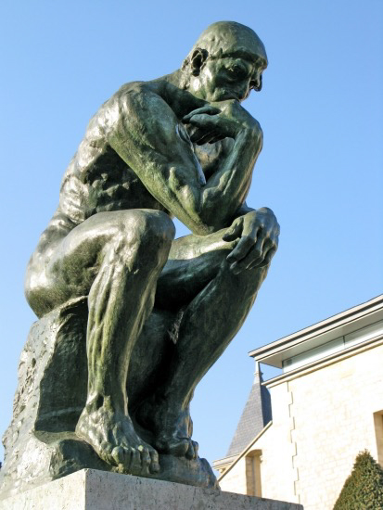
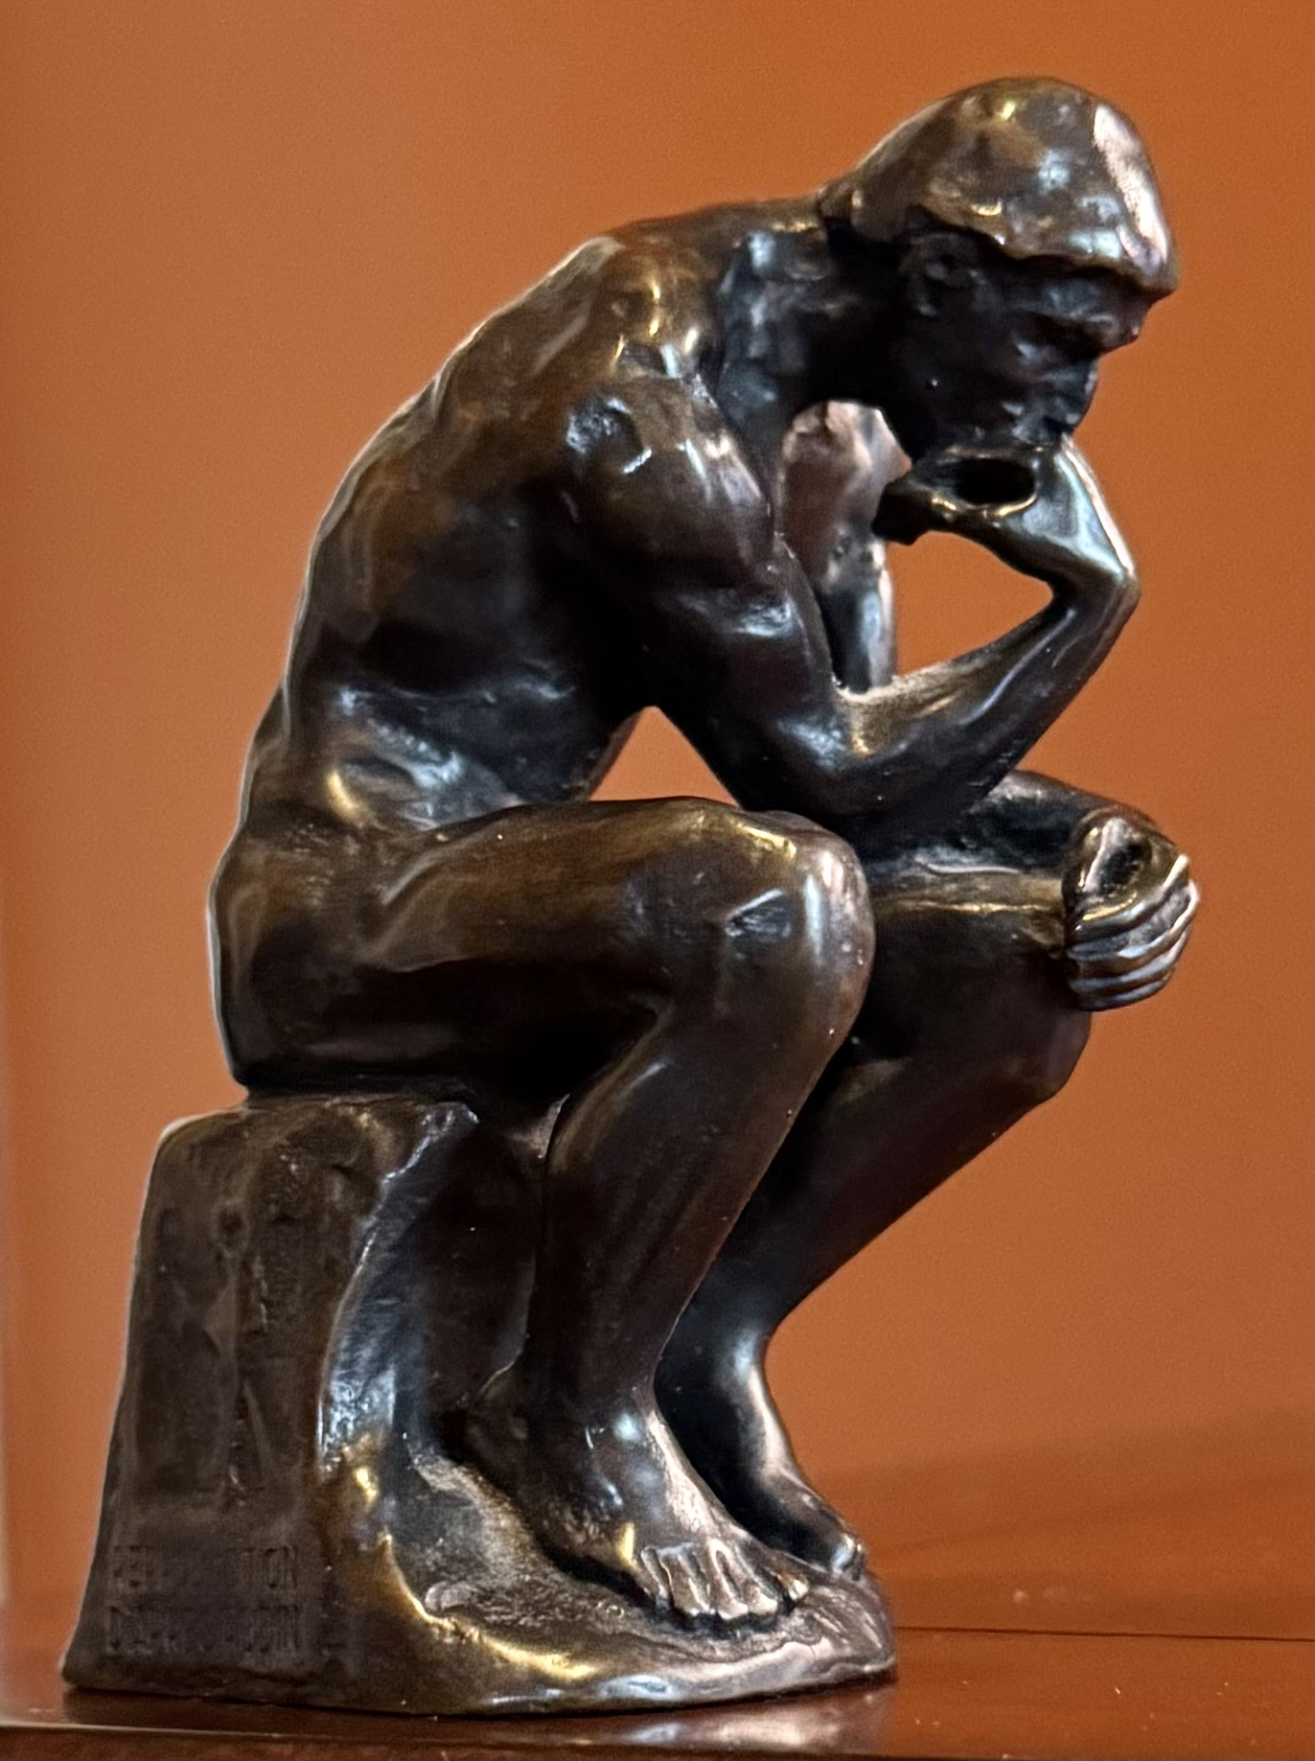
Le Penseur
by
Auguste Rodin
Notes:
And here he is in person

Slide 6
Review
We defined some definitions terms.
  Apologetics: “A reasoned defense of the Christian religion”
Classical Apologetics, Sproul, Gerstner, and Lindsey
I introduced Le Penseur (The Thinker) to show our active role (our thinking role) in apologetics.
Our reasoned defense is based on the principle in Isaiah 1:18,
  “Come now, let us reason together says the Lord”
The unplanned nature of encounters (“you never know”)
The planned nature of encounters (“you should know”)
A key verse in apologetics is I Peter 3:15:
  “but in your hearts honor Christ the Lord as holy, always being prepared to make a defense to anyone who asks you for a reason for the hope that is in you; yet do it with gentleness and respect,…”
Notes:
We cannot convince people of hope, but we can encourage it.

Slide 7
Review
  In a sense, God takes a risk when entrusting us with this responsibility.
    “Therefore, we are ambassadors for Christ, God making his appeal through us. We implore you on behalf of Christ, be reconciled to God.” II Corinthians 5:20
  We introduced the concept of epistemology:
    “the theory of knowledge, especially with regard to its methods, validity, and scope. Epistemology is the investigation of what distinguishes justified belief from opinion”
Questions/comments?

Slide 8
Apologetics II
There is a term known as natural theology: The study of God based on what one can know from nature. A grasp of this might help.
    1. Cosmological argument: The universe exists, so there must be a cause
    beyond the material.
    2. Teleological argument: If there is a design; there must be a Designer. (Psalm
    19:1-6)
    Teleology: “The study of design or purpose in natural phenomena.”
    3. Ontological argument: Comes from the idea that God is an absolutely perfect or necessary being
    Ontology: “The branch of metaphysics that deals with the nature of being.”

Slide 9
Apologetics
  4. Moral argument: There is an “ought to” in all humans.
      “These, then, are the two points I wanted to make. First, that human beings, all over the earth, have this curious idea that they ought to behave in a certain way, and cannot really get rid of it. Secondly, that they do not in fact behave in that way. They know the Law of Nature; they break it. These two facts are the foundation of all clear thinking about ourselves and the universe we live in.”
        Mere Christianity by C.S. Lewis
Let’s now look at some specifics.

Slide 10
Apologetics II
“Let me introduce you to God.”
  If a seeker is drawn to consider God from one of the natural theology arguments, the next step seems to be to tell seeker about your God.
  Fortunately, there is an objective source of information about Him which is…
  the Bible.
  If appropriate, there are resources about the reliability of the Biblical pages and ink.
    Manuscripts, archeology, internal consistency, etc.
  The written Word
    The place to start because:
      Readable
      Exclusive information
      Commonality of information
      Trusted by people for thousands of years
        To the point of some giving their lives

Slide 11
Apologetics II
“Let me introduce you to God.” (cont.)
  The living Word in the written word
    We should be able to explain Who He was and is, what He did and does, and what He expects of us.
    Let’s just look at Who He was and is, His deity.
      John 4:25, 26
      John 8:57-59
Notes:
John 8: the endless present tense

Slide 12
Apologetics II
“I am trying here to prevent anyone saying the really foolish thing that people often say about Him: ‘I’m ready to accept Jesus as a great moral teacher, but I don’t accept His claim to be God.’ That is the one thing we must not say. A man who was merely a man and said the sort of things Jesus said would not be a great moral teacher. He would either be a lunatic—on a level with the man who says he is a poached egg—or else he would be the Devil of Hell. You must make your choice. Either this man was, and is, the Son of God: or else a madman or something worse. You can shut Him up for a fool, you can spit at Him and kill Him as a demon; or you can fall at His feet and call Him Lord and God. But let us not come with any patronizing nonsense about His being a great human teacher. He has not left that open to us. He did not intend to.”
Mere Christianity by C.S. Lewis

Slide 13
Apologetics II
“Answer me this”
  Apologetics at its core is questions and answers.
    The questioning can be from the seeker.
      It is easier if questions are sincere.
      If questions are insincere, avoid the debate-trap.
    The questioning can be from the apologist.
    We need to be sure that what a seeker is asking is the real question.
      Ex. “Is the Bible reliable?” > “Does God really communicate through the written word?”
  Realize that the Holy Spirit is part of the conversation.
    Luke 12:11, 12
    John 14:25, 26
Notes:
#6

Slide 14
Apologetics II
Let’s look at one common genre of questions: How can a good God allow deadly catastrophes, like the recent Guadelupe River flood?
  We must have some response that is not off the cuff.
  Remind the questioner that God doesn’t give man all the answers, but that you do know something of the character of God ( the example of Job).
  There is an implication that the questioner is considering the existence of God.
  There is an assumption that God has the power to prevent tragedies.
  Does the questioner think that God is answerable to us?
  What kind of God would accept judgement from man?
  A response from us might be: “Would you give God credit for the good before the tragedy, as well as after?”
  If God prevented affliction, comfort would not exist.
    II Corinthians 1:3, 4

Slide 15
Apologetics II
  Ultimately, we only know what we know.
    Luke 13:1-5
      Does Jesus give a reason for the deaths?
        No and yes
          Were they “worse sinners” or “worse offenders?”
          “no” and “no”
          All were sinners (like all of mankind). (the ‘yes”)
          God decides the timing of such interventions…leave that part alone.
          “No, I tell you, unless you repent, you will all likewise perish.” x2
          Death closes the door on the possibility of repentance.
      Jesus perfectly understands the weight of Gospel preaching and apologetics.

Slide 16
Apologetics II
Apologetics is one aspect of evangelism.
  II Corinthians 5:20, 21
  Acts 16:29-32
    Why was the jailer fearful?
    What may have been some of what Paul and Silas told him?
      “There is something worse than physical death.”
      “God has provided an answer for one-time physical death as well as ongoing death in hell.”
  Isaiah 1:18 (again)
    “Come now, let us reason together, says the Lord: though your sins are like scarlet,
    they shall be as white as snow; though they are red like crimson,
    they shall become like wool.”
    This may be more difficult to understand than ”natural” disasters.
    It could be a good close with the seeker.
    It is a good close for us.

