Slide 1
A Christian Worldview
How Do You See The World

Slide 2
Outline
Where did I come from
Worldview I
Worldview II
Did it start at creation ?
Why did the created disagree with the creator ?
What am I Doing Here
Redemption
A disciplined life is an unburdened life
Music, art, literature
Apologetics 1
Apologetics 2
It’s a matter of birth and death
Reflecting the Divine
Where Am I Going
Heaven, Hell or Oblivion
A light at the end of the Tunnel
(PP’s at davenancymorris.com > Worldview > A Christian Worldview)

Slide 3




“To have a Christian-Biblical worldview is to have the perspective
Of seeing the world as God sees it. Rev. Steve Jennings

Slide 4
Review
Second week on apologetics
Natural theology has to do with the study of God based on what one can know from nature.
  The most personal and convicting is the moral argument which says that there is an “ought to” in all humans and that all humans fall short of their own standards.
We discussed the liar, lunatic, or Lord argument of C.S. Lewis.
We discussed some approaches to answering the question of how God allows natural disasters.
If we are doing God’s work of giving a defense of the hope that is within us, remember that the Holy Spirit comes along side us.
Questions/comments

Slide 5
It’s a Matter of Birth and Death
How does this fit into a Christian Worldview under What Am I Doing Here?
  God declared His crowning act of creation of human life on the sixth day to be “very good” (Genesis 1:31).
  Jesus entered this world and participated in the human process (John 1:14).
  Part of why He left heaven was to be born and to die as a human being.
  In the incarnation, Jesus not only “emptied Himself by taking the form of a servant” (Philippians 2:7), but it also elevated the value of human life.
    He elevated the value of the beginning of a human’s life (pre-birth and birth).
    He elevated the value of the end of a human’s life.
  If we are concerned about the question, What Am I Doing Here?, and if we are ambassadors for Christ, we will want to understand and explain God’s design for life.

Slide 6
It’s a Matter of Birth and Death
Let’s start at the beginning of a human life, which is…
  a Divine plan
  Psalm 139:13-16
    What if God were surprised by the conception, fetal growth, and birth of a new life?
    What kind of eyes does God have?
      Perfectly accurate
      Able to see retrospectively
      Able to see prospectively
      Able to see our form when it was “unformed.”
    What does the word “unformed” imply?
Notes:
Read 139:13-16

Slide 7
It’s a Matter of Birth and Death
Next comes the time of prebirth (I don’t like the terms fetus or fetal).
  Psalm 139:13-15
    Why “formed and not “made” or “manufactured?”
    What’s the difference between “formed” and “knitted?”
    Which pre-born and being-formed baby is not “fearfully and wonderfully made?”
    I doubt that there is a human who does not agree with 14b.
    What is secret about our “being made?”
      Visually
      Intellectually

Slide 8
It’s a Matter of Birth and Death
The pre-birth process (cont.)
  Jeremiah 1:4, 5
    This certainly specific to Jeremiah.
    Have other “consecrated” people been aborted?
  Luke 1:39-44
    Apparently, Elizabeth knew the difference between her pre-born baby just leaping and his leaping for joy.
    Did anyone else leap for joy?
      Elizabeth was 6 months
      Mary was at least 3 months behind her, let’s say at 13 weeks.
      Quickening is around 18 weeks.
      If Jesus leaped for joy, Mary would not have known it.
      Since we do not know one way or the other, I propose that He did.
  https://youtu.be/eMJQgQBDUDo

Slide 9
It’s a Matter of Birth and Death
Birthing
  Luke 2:6, 7
  The most important and dramatic event for the pre-born
  Now, God’s ‘formed” work is visible for all to see!
  God honored the birth process by Jesus going through it.
Between birth and death next week

Slide 10
It’s a Matter of Birth and Death
The sacredness of death
  Psalm 116:15
    What does precious mean?
      ”of great value; not to be wasted or treated carelessly”
      Is this true of natural death?
      Is it true of ”accidental” death?
      Is it true of a martyr-death?
        “Be of good comfort Master Ridley, and play the man. We shall this day light such a candle by God's grace in England, as (I trust) shall never be put out.” Hugh Latimer as they were both burned at the stake in Oxford, England in 1555
  Psalm 72:12-14
    Even the death (“their blood”) of the poor, needy, and weak is precious in His sight.

Slide 11
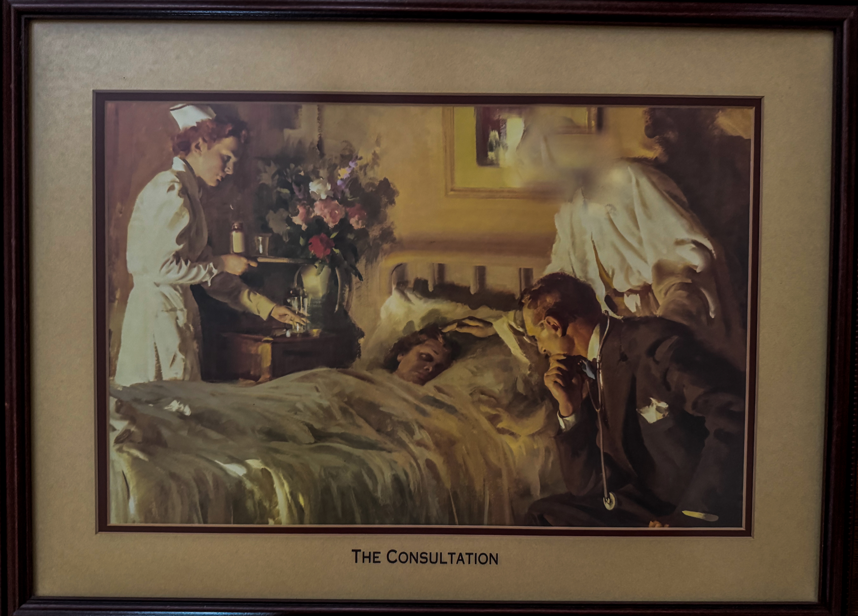
Harry Anderson

Slide 12
It’s a Matter of Birth and Death
Acts 7:58-60
  We do not know if or how Jesus responded to Stephen’s words, “Lord Jesus, receive my spirit,” but…maybe He said:
    “I do receive it for it is precious in My sight.”
Next week: Applying some of these issues to everyday living as we discuss sanctification or Reflecting the Divine

