Slide 1
A Christian Worldview
How Do You See The World?

Slide 2




“To have a Christian-Biblical worldview is to have the perspective
Of seeing the world as God sees it. Rev. Steve Jennings

Slide 3
Outline
Where did I come from
Worldview I
Worldview II
Did it start at creation ?
Why did the created disagree with the creator ?
What am I Doing Here
Redemption
A disciplined life is an unburdened life
Music, art, literature
Apologetics 1
Apologetics 2
It’s a matter of birth and death
Reflecting the Divine
Where Am I Going
Heaven, Hell or Oblivion
A light at the end of the Tunnel
(PP’s at davenancymorris.com > Worldview > A Christian Worldview)

Slide 4
Review
Steve led us in a survey of the Biblical doctrine of hell.
According to the Bible, there is only a black (hell) or a white (heaven) destiny and no gray for people.
Hell is eternal punishment.
  “And these will go away into eternal punishment, but the righteous into eternal life.” Matthew 25:46
  ^{“6} since indeed God considers it just to repay with affliction those who afflict you,⁷ and to grant relief to you who are afflicted as well as to us, when the Lord Jesus is revealed from heaven with his mighty angels ⁸ in flaming fire, inflicting vengeance on those who do not know God and on those who do not obey the gospel of our Lord Jesus. ⁹ They will suffer the punishment of eternal destruction, away from^{[a]} the presence of the Lord and from the glory of his might,” II Thessalonians 1:6-9

Slide 5
Review
The atheist defines his/her own terms and proudly relies on oblivion at death.
  No basis
  The logical end for the evolutionist (from nothing to nothing)
  This is his insurance policy without a document or insurance company.
  This is wistful thinking.
Questions/comments

Slide 6

Notes:
Oblivion now and forever!

Slide 7
Where Am I Going?
A Light At The End Of The Tunnel
In 1678, John Bunyan wrote a book about a jailed-dreaming man with a book, a burden, his journey toward a faint light, and his final arrival at the place of light.

Slide 8
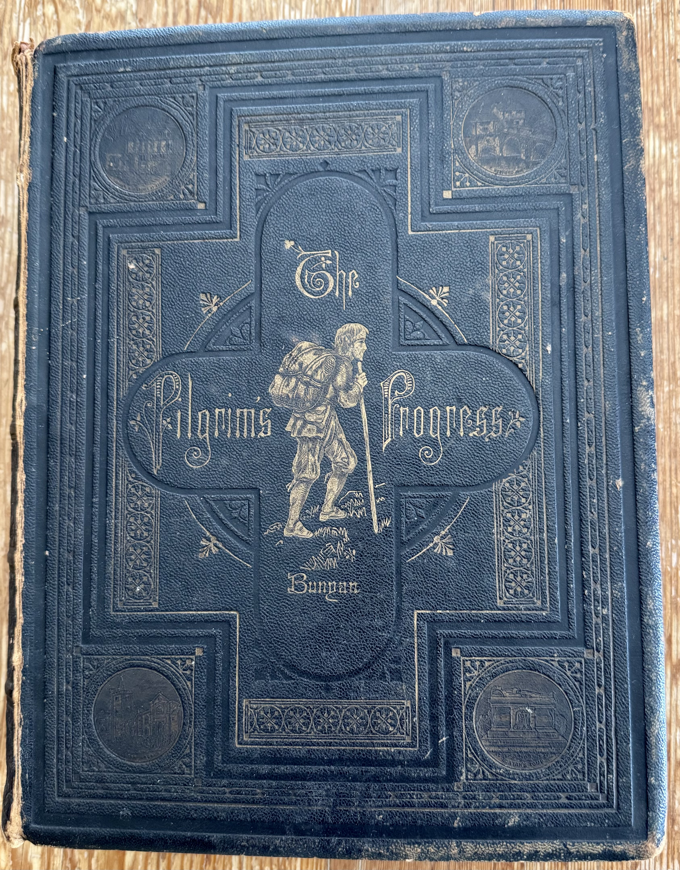

Slide 9
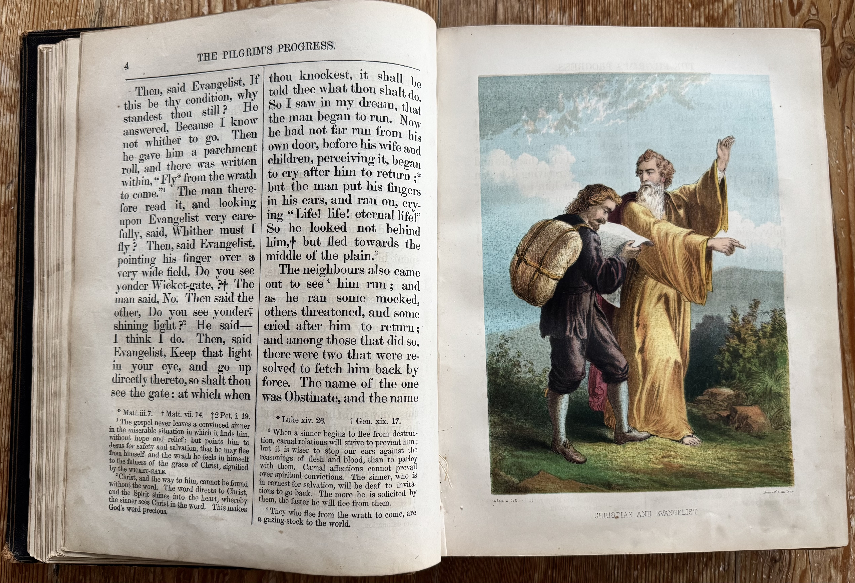
Notes:
1874 Edition

Slide 10
Where Am I Going?
A Light At The End Of The Tunnel
In 1678, John Bunyan wrote a book about a jailed-dreaming man with a book, a burden, his journey toward a faint light, and his final arrival at the place of light.
This book reflected his worldview, especially where he was going.
The Celestial City (heaven) was his and is our goal at the end of the journey from birth to death.
If a worldview does not have an explanation of where one is going, it is pretty useless.
This morning, we will first shed some Biblical light on heaven and then, discuss some applications of that light.

Slide 11
A Light at the End of the Tunnel
No one has seen heaven, right?
We do have some witnesses.
  Jesus
    John 14:1-3
  Paul
    II Corinthians 12:1-4
  John
    Revelation 4:1, 2
  Stephen
    Acts 7:54-56
  Isaiah
    Isaiah 6:1-4

Slide 12
A Light at the End of the Tunnel
Who inhabits heaven?
  Hebrews 12:22-24
    Angels
    “First-born who are enrolled in heaven”
      Probably, means believers: past, present, and future (Bruce)
    “God, the judge of all”
      The one enthroned
    “Spirits of the righteous made perfect”
      Pre-Christian-day believers
    Jesus
      Mediator of old and new
      Recognizable physical body

Slide 13
A Light at the End of the Tunnel
Some features of heaven
  Rest (Revelation 14:13)
  Knowledge (I Corinthians 13:8-12)
  Holiness (Revelation 21:27)
  Service (Revelation 22:3)
  Worship (Revelation 22:3, 19:1)
  Glory (II Corinthians 4:16-18)

Slide 14
Notes:
Rejection of darkness and of light

Slide 15
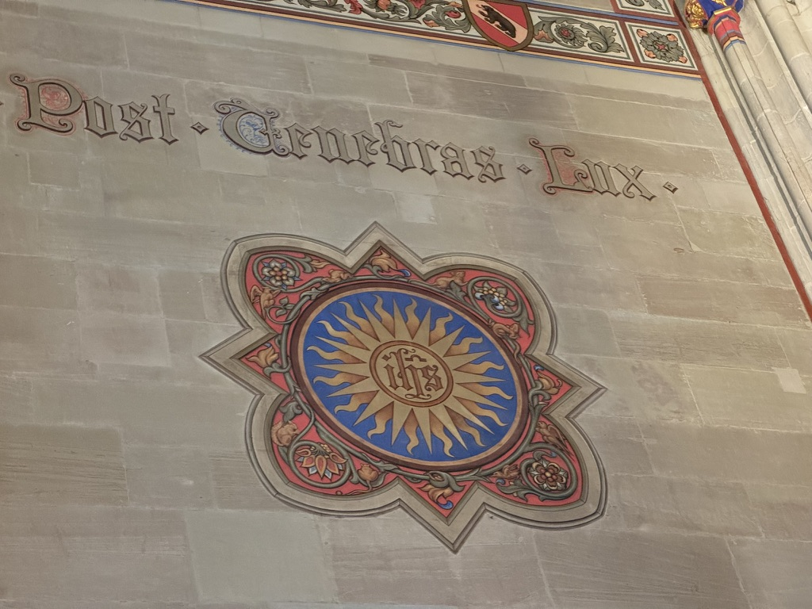
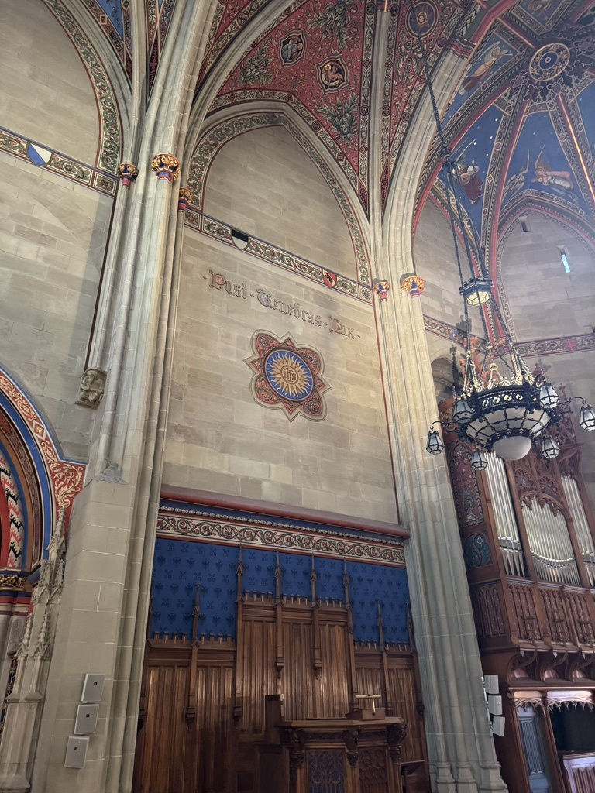
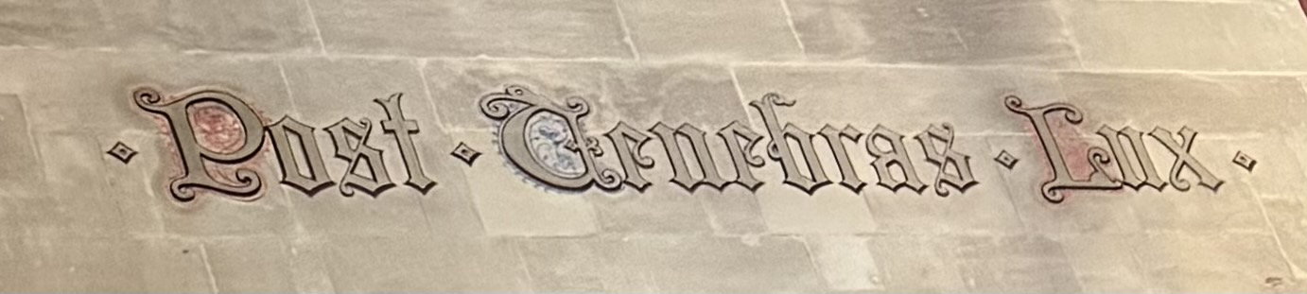

Slide 16
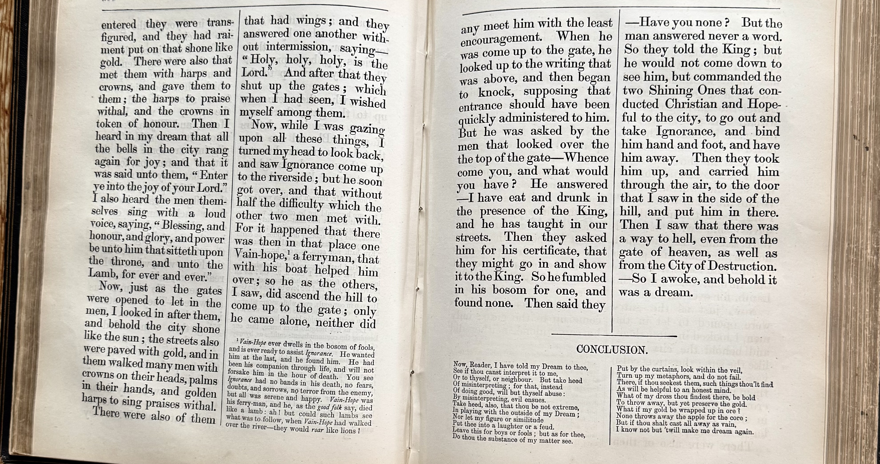

Slide 17
A Light at the End of the Tunnel
Application Of the Heavenly light
  Psalm 119:105
    When does one need a lamp and a light?
      When there is darkness and lack of clarity
    Is there a difference between ”a lamp to my feet” and ”a light to my path?”
      Lamp
        When there are trip-potentials here and now
      Light
        When the way forward is less clear
  I Corinthians 13:12
    A Christian worldview can be dimmed or blurred this side of heaven.
    But when we get to where we are going, truth will provide clarity on who we really are and on what our loving God’s plan has been forever, what it is, and what it will be forever.

